Slide 1
AI -101 PROJECT GROUP 20
Student Performance
Prediction
DATA→https://archive.ics.uci.edu/dataset/320/student+performance
MODEL WE USED →Linear Regression
PREDICTION →13.07 grade points
Predicting a student’s final Mathematics grade (G3) from academic and personal attributes.
TEAM NO.: [20]
MEMBERS: [Sajal Choudhary, Rajarshi Ghosh, Madhav Gupta, Jaipal Nayak]
ROLES: Data • Preprocessing • Modelling • Evaluation
REPOSITORY LINK: [https://github.com/2026aib1074-oss/Student-Grade-Prediction]

Slide 2
Problem & dataset
What are we predicting, and what information does the model use?
THE PROBLEM
Predicting final mathematics grade of students
By using study habits, academic factors, using
Linear Regression
DATA SOURCE
https://archive.ics.uci.edu/dataset/320/student+performance
DATA USED IN THIS RUN
.
.
Records: 649 students
Input Features: 33
Target: Final Grade (G3)
Train-Test Split: 80:20 (G1 and G2: Excluded from input features)
FEATURE GROUPS
Demographics: age, sex, address,
Family Background:Parent education, parent jobs, family support
Academic & School: Study time, past failures, school support, absences
Social and Lifestyle: Free time, going out, alcohol consumption, health, internet access
649
33
20%
42
students
columns
test split
random seed
Important: The dataset includes student demographic, social, family and academic attributes. The model predicts the final Mathematics grade (G3)
2/5

Slide 3
Approach
A reproducible supervised-learning pipeline
01 INPUT DATA
02 PREPROCESS
03 TRAIN MODELS
04 PREDICT
05 EVALUATE
Student records
33 columns
→
One-hot encode
categories; scale
numeric features
→
80% train / 20% test
Fixed random seed = 42
→
Regression models
estimate G3
→
MAE • RMSE • R²
compare test results
MODELS TESTED
LIBRARIES & IMPLEMENTATION
Linear Regression
Algorithm: Ordinary Least Squares Linear Regression
Library: Scikit-learn
Preprocessing: Median imputation + One-Hot Encoding
Implementation: Scikit-learn Pipeline
Output: Final Mathematics Grade (G3)
Python • pandas • NumPy • scikit-learn • Matplotlib
Pipeline: Column Transformer + One Hot Encoder + Standard Scaler + regression estimator.
No manual copying of test labels into training.
3/5

Slide 4
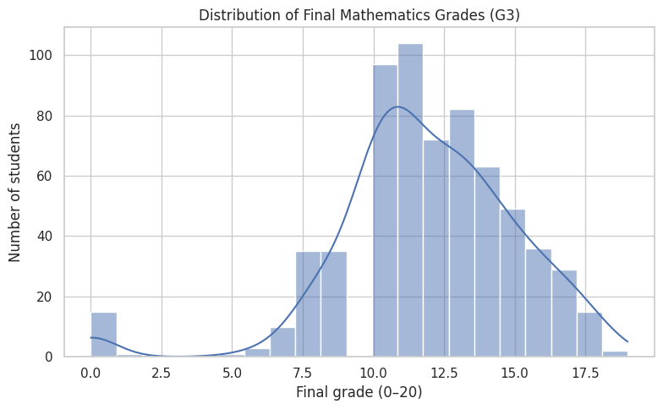
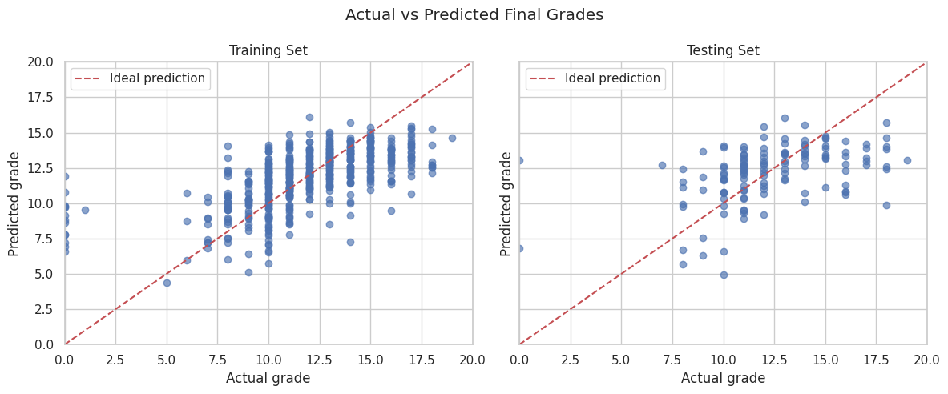
Results
0.387
R² score for
Training performance
1.832
MAE(grade points) for
Training performance
2.539
RMSE(grade points) for Training performance
Held-out test-set performance (for students)
0.160
2.156
2.862
R² score for
Testing performance
MAE (grade points) for
Testing performance
RMSE (grade points) for
Testing performance
DEMO OUTPUT
The graph compares actual and predicted student grades. The deviation of points from the ideal prediction line indicates prediction errors on both training and testing data.
4/5

Slide 5
Learnings & next steps
What worked, what needs improvement, and responsible AI use
WHAT WORKED
LIMITATIONS
1) Limited dataset diversity
2) External factors affecting academic performance are not fully captured
4) Linear Regression may fail to model complex, non-linear relationships.
NEXT IMPROVEMENTS
1)Successfully loaded and processed the UCI Student Performance dataset.
2)Applied preprocessing to handle missing values and convert categorical data into numerical features.
3)Built a Linear Regression model using a Scikit-learn pipeline.
4)Used a train-test split (80:20) to evaluate model performance.
5)Successfully predicted students' final Mathematics grades (G3)
1) Perform feature selection and hyperparameter tuning.
2) Collect more diverse student data to improve generalization.
3) Experiment with Random Forest and other regression algorithms.
WHO DID WHAT? (AFTER FINAL DISCUSSION)
AI-USE DISCLOSURE
Sajal-GitHub collaboration and documentation
Rajarshi- PPT making
Jaipal- Video making
Madhav- Setup and Steps to execute
AI tools were used selectively for assistance with understanding concepts, debugging, and improving the presentation. The project workflow, dataset analysis, model evaluation, and final interpretation were reviewed by the team
5/5

